Slide 1
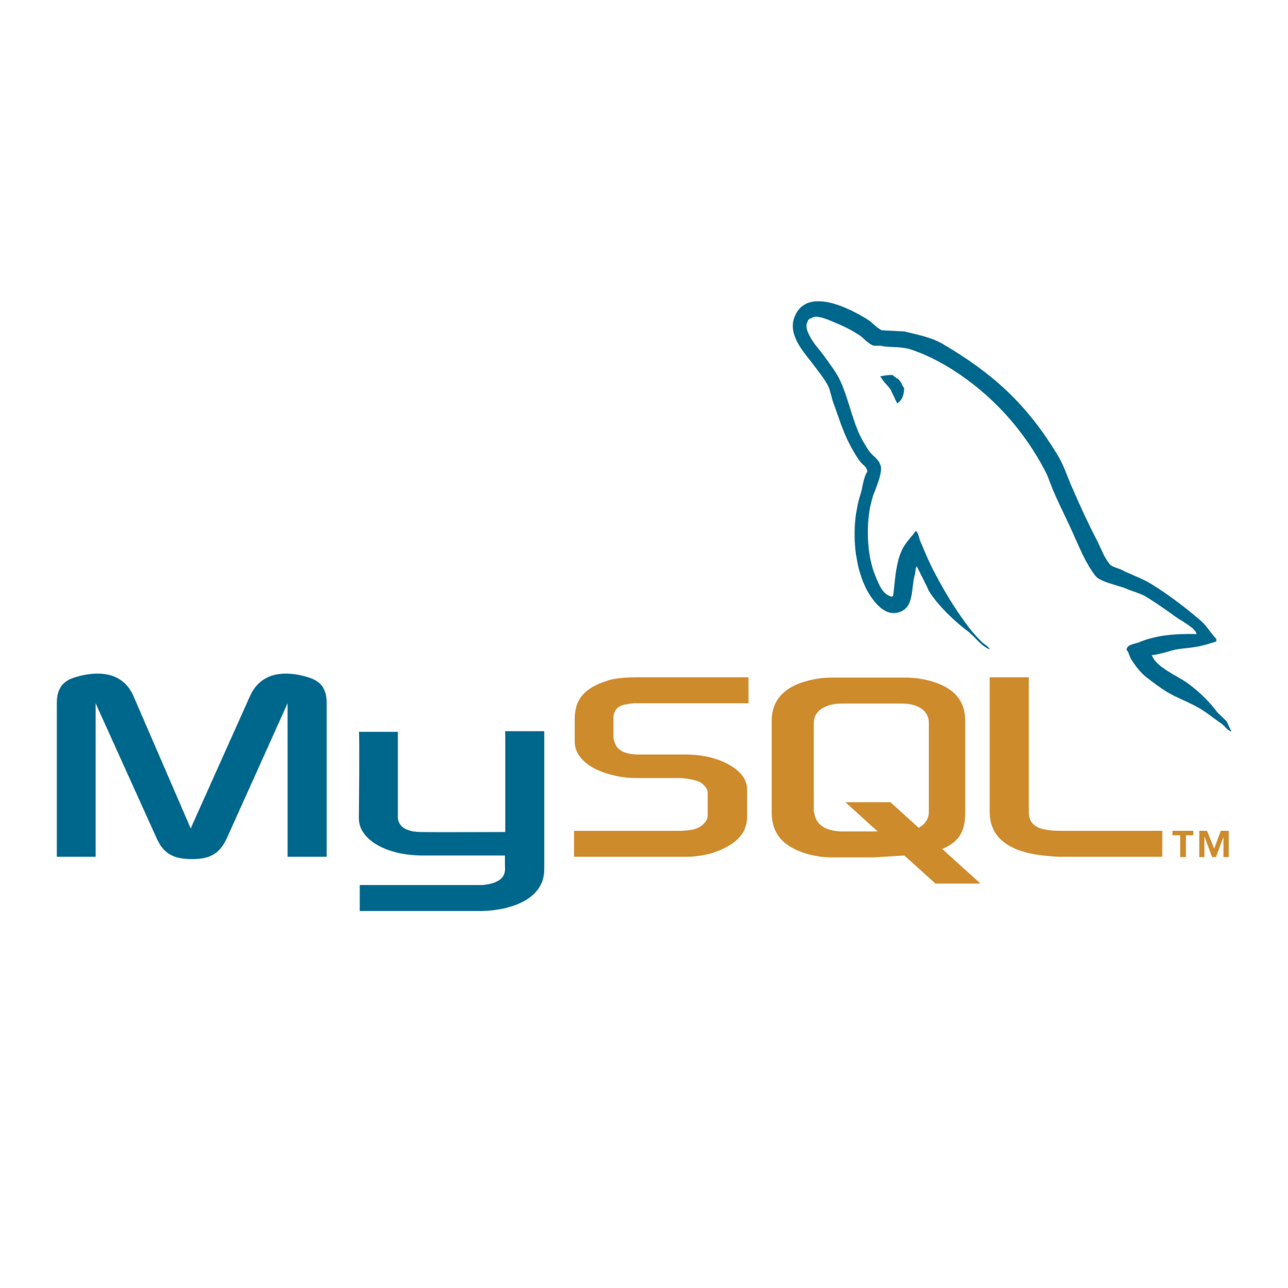



PROJECT 1
Spark code to read data from mysql, do
some processing and store output data back to hive

Slide 2
Introduction
Data: The data used for this task is a flight attendant table . The table “Flight” was read into Scala-Spark.
It contains 1391578 rows and 3 columns which are date, distance, origin and destination.
The data was extracted to .csv based on the requirement that it should be moved to hive after being read

Slide 3

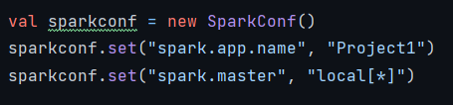
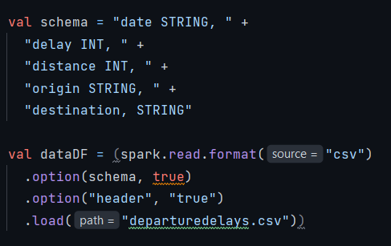
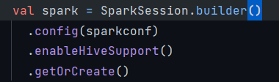
Set-Up
To access codes, click here

Slide 4
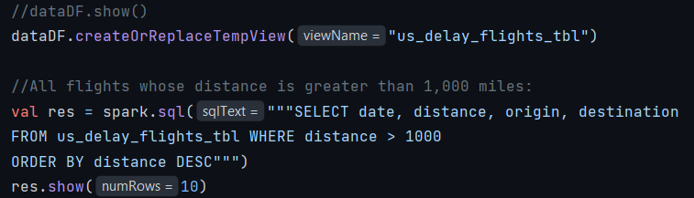
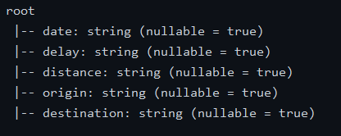
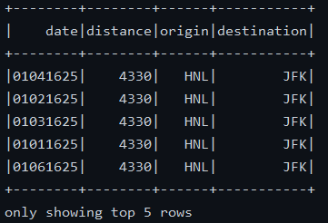
Processing
To access codes, click here

Slide 5
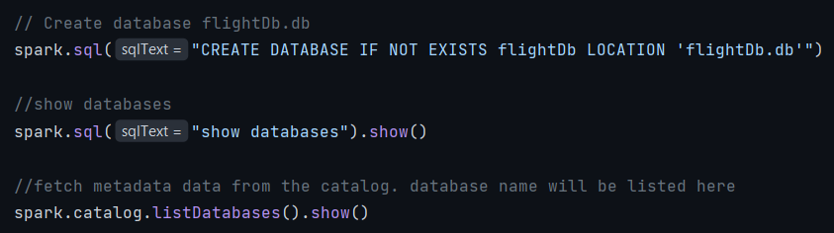
Loading into Hive
Hive was used as a data warehouse to store historical data so as to assist when there is a need for further processing to support managerial decision. The whole table was written to .csv file and loaded into hive. The code to write to .csv file in scala-spark was
To access codes, click here

Slide 6
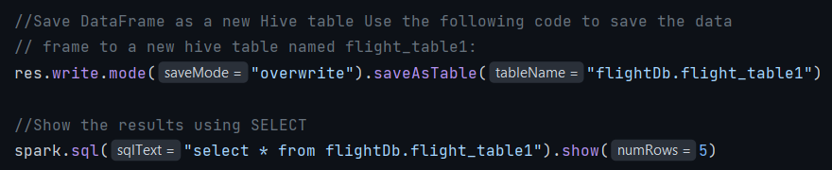
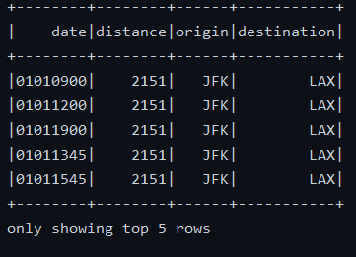
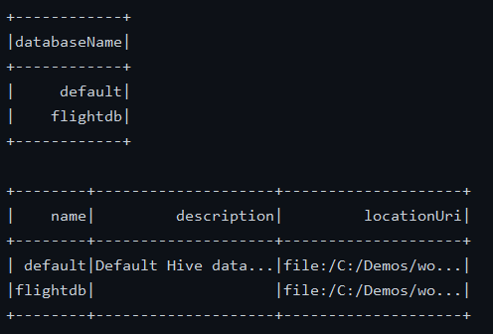
Loading into Hive
To access codes, click here

Slide 7
THE END

